Slide 1
COOPERATION CANADA 101

Slide 2
Who we are
What we do
How we can support you
How to best engage with us
AGENDA

Slide 3
WHO WE ARE
Cooperation Canada is the national association of international development and humanitarian organizations. It brings together and advocates for Canada’s international cooperation and humanitarian organizations by convening sector leaders, informing policy and building capacity. Together, we work with partners both inside and outside Canada to build a world that is fair, safe and sustainable for all.

Slide 4
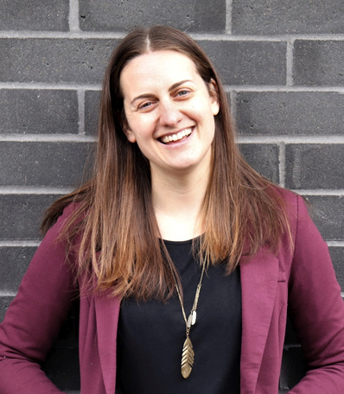
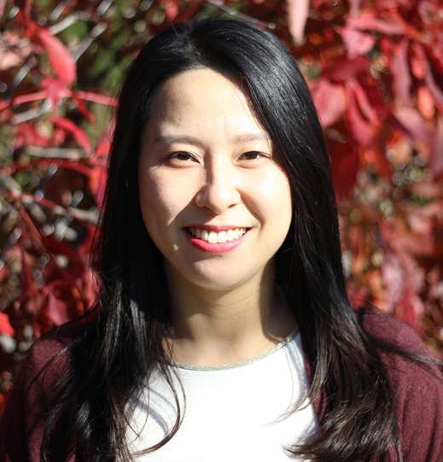
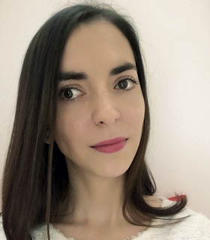
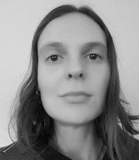
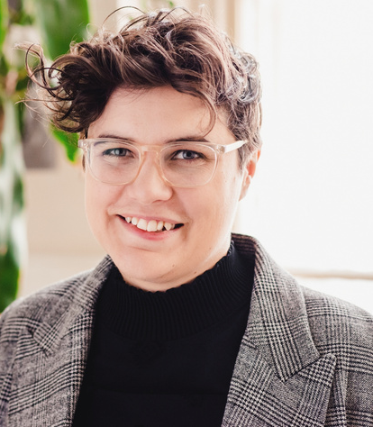
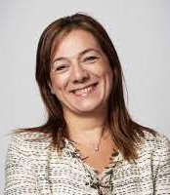
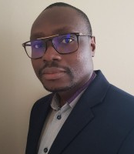
MAXIME MICHEL​
SHANNON KINDORNAY​
SEOHYUN​
IN
GLORIA NOVOVIC​
ANA
DE OLIVEIRA
OUR CENTRAL TEAM
Director, Research, Policy & Practice​
Senior Manager, Operations & Finance​
Policy ​
Lead​
Research & Knowledge Management Officer
Interim - CEO​
MP
BOISVERT
FANTA
DIABY
RITA SROUR
SHANNON
KINDORNAY
HUGHES
ALLA
MARK EDWARDS
Senior Manager, Member and Stakeholder Relations
FATIMA AMAROUCHE
Member Services Liaison
Events
Coordinator
Communications Assistant
Website & Database Administrator
Accounting Officer

Slide 5
COOPERATION CANADA IS ACTIVELY RECRUITING A NEW CEO!
Until then, the Interim CEO is:
October-December: Maxime Michel
January-March: Shannon Kindornay
CEO TRANSITION
Accounting Officer

Slide 6
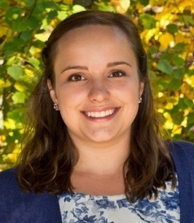
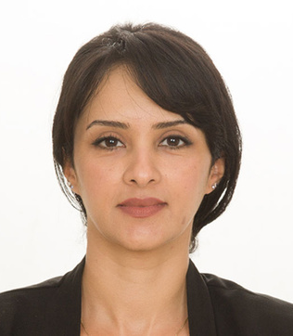
Trainings
Online resources
Consultation services
Leaders’ Pledge
HRN
Coordinator
AISLYNN
ROW
NOELIA
RUIZ
LINA
SHAMSADIN
Digna Program
Manager
Digna Program Assistant
HRN
Coordinator
digna.ca
THE CANADIAN CENTRE OF EXPERTISE ON THE PREVENTION OF SEXUAL EXPLOITATION AND ABUSE
OUR PROJECT TEAMS

Slide 7
HRN
Coordinator
AISLYNN
ROW
LINA
SHAMSADIN
The Humanitarian Response Network of Canada (HRN) is a vibrant community of practice made of 38 Canadian Humanitarian Organisations.
Digna Program
Manager
HRN
Coordinator
HUMANITARIAN RESPONSE NETWORK
OUR PROJECT TEAMS

Slide 8
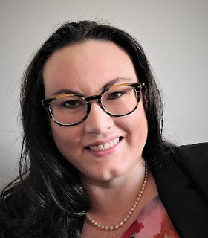
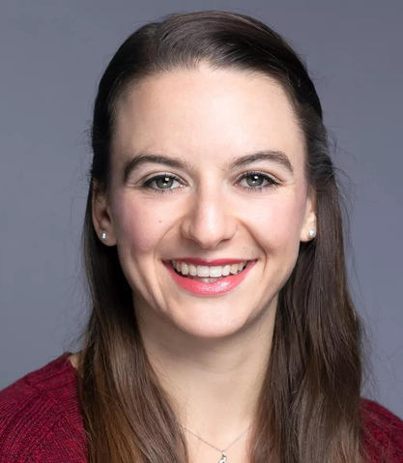
Collaborating with the ODA working group, sector stakeholders, and sector allies, Bigger Than Our Borders develops and implements strategic campaigns that encourage increases to Canada’s commitment to international cooperation in pursuit of a fairer, healthier, and more resilient world.
SARAH MAGEE
CIANA
VAN DUSEN
ODA Campaign Director​
ODA Campaign Coordinator​
OUR PROJECT TEAMS
BIGGER THAN OUR BORDERS (THE ODA CAMPAIGN)

Slide 9
Richard Veenstra
Mission Inclusion
Christine Bui
Oxfam-Québec
Dr. Dorothy Nyambi
MEDA
Eileen Alma
Coady Intl. Institute
Janice Hamilton
MCIC
OUR BOARD
Leah Ettarh
ACGC
Katharine Im-Jenkins
WUSC
Nabil Ali
IDRF
Nicole Hurtubise
WaterAid Canada
Marc Bonomo
SOS Children’s Villages
Michèle Asselin
AQOCI
Odette McCarthy
Equitas
Pascal Paradis
Avocats Sans Frontières
Tanjina Mirza
Plan International

Slide 10
ENABLE
Foster a more collaborative, connected and inclusive sector
LEAD
Advance the voice, expertise and leadership of civil society
OUR OBJECTIVES
INNOVATE
Inspire and support a more relevant, responsive and effective sector
Operational Strategy
2019 - 2023
THRIVE
Pursue operational resilience to deliver greater and more effective impact
I
I

Slide 11
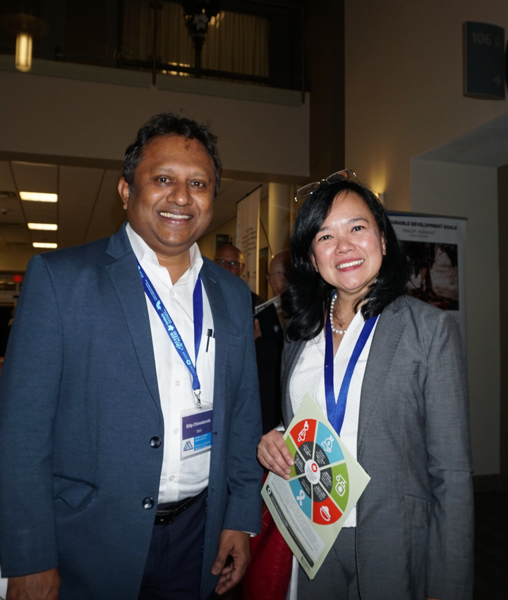
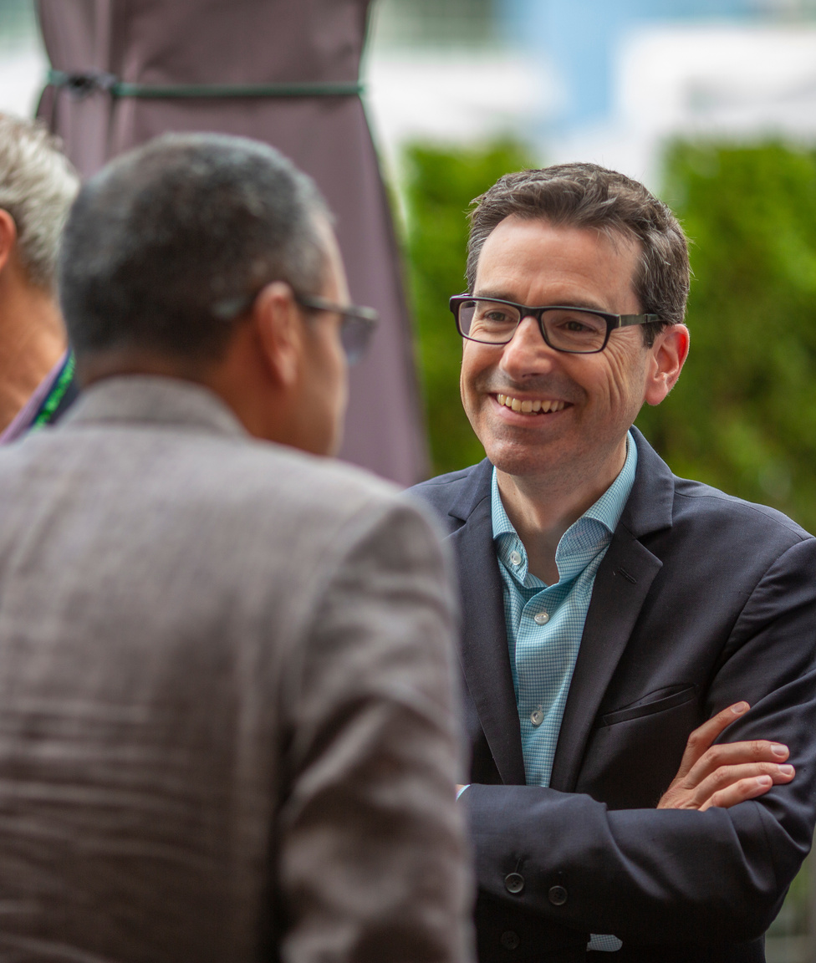
ENABLE: Building an enabling environment
Diverse, predictable and responsive funding
Meaningful and inclusive dialogue
Supportive and conducive legislative, regulatory and policy frameworks
ENABLE
CONVENE
COORDINATE
COMMUNICATE

Slide 12
ENABLE IN ACTION
ANTI-RACIST COOPERATION:
COOPERATION FORUM & AGM
ANNUAL CONFERENCE
HILL DAYS
Anti-Racism Framework for Canada’s International Cooperation Sector
ENGAGING WITH THE MINISTER OF INTERNATIONAL DEVELOPMENT
WORKING GROUPS &
COMMUNITIES OF PRACTICE

Slide 13
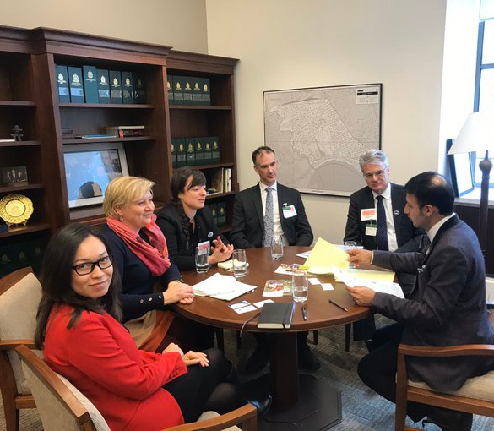
Advance the voice, expertise and leadership of civil society
RESEARCH AND ANALYSIS
LIAISE WITH GAC
LEAD
POLICY INFLUENCE
BUILD CAPACITY
ETHICS AND STANDARDS

Slide 14
Informing policy frameworks​
Feminist Foreign Policy​
Triple Nexus​
Mainstreaming environmental objectives​
​
Advocating for effective assistance​​
Official Development Assistance​
Updating Direction and Control legislative framework​
Canada's engagement in OECD/DAC ​
Canada's engagement in G7 initiatives
Current happenings
Research on civic space and SDGs​
GAC CSO Policy & Coordination Groups ​
Localization​
Pulse checks​
CSO advisory group​
GAC consultations​
Research on sector diversity & reconciliation​
Indigenous reconciliation paradigm initiatives
LEADING IN ACTION

Slide 15
INSPIRE AND SUPPORT A MORE RELEVANT, RESPONSIVE AND EFFECTIVE SECTOR
CREATING AND SHARING RESOURCES TO HELP YOU BUILD YOUR CAPACITY TO INNOVATE EFFECTIVELY
PROFILING YOUR INNOVATIVE WORK
INNOVATE

Slide 16
SOME HIGHLIGHTS
OF OUR YEAR

Slide 17
Events
Community
THRIVE:
HOW CAN WE SUPPORT YOU?
Expertise
Access and Influence
Research and Analysis
Promotion

Slide 18
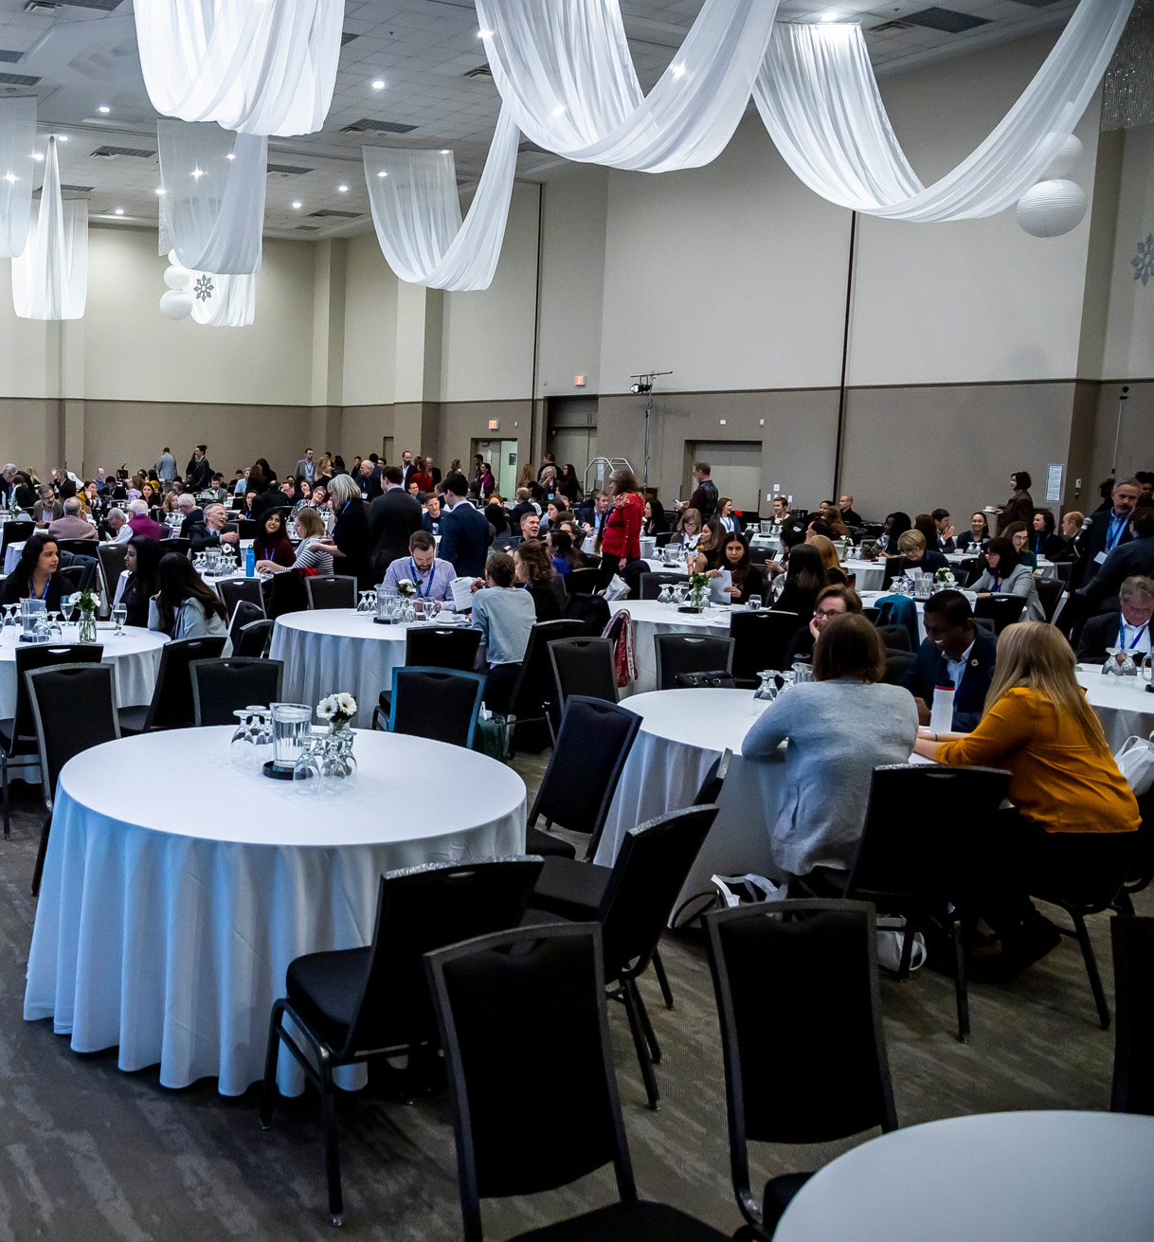
RECURRING EVENTS
Cooperation Forum​
Annual Conference
Awards Ceremony
AGM
Hill Days
CEO-ED check-ins
OUTREACH AND EVENTS
SPECIAL EVENTS
Afghanistan Crisis Exchange
Townhalls
Workshops and webinars
GAC Consultations and Dialogues

Slide 19
Cooperation Canada is pleased to offer event support to its members!
Our Event Team can offer services for online, hybrid and in person (in Ottawa) events. We could help with...
Consultation on the best way to hold your event
Registration options
Logistics
Online conference platform that best suits your event
Post-event report
Budget management
and more!
E-mail our Events coordinator, Rita Srour, for more information: rsrour@cooperation.ca
NEED HELP WITH YOUR EVENTS?

Slide 20
Our working groups (WGs) come in lots of shapes and sizes!
They are formed around themes (ex: Localization) or policy pieces (ex: Direction and Control)
Communities of practice stem from specific divisions,
like HR, CFOs or PSEA!
Questions about WGs and CoPs?
Want to join one or create one?
Contact our Member Services Liaison, Fanta Diaby: fdiaby@cooperation.ca
WORKING GROUPS & COMMUNITIES OF PRACTICE

Slide 21
Africa Canada Forum​
Asia-Pacific & Philippines
Chief Financial Officer​s (CFOs)
Communications​ (dormant!)
Innovative Finance​
Human Resources (HR)
Youth Engagement​
Fundraising ​
Direction & Control​ (new!)
Localization​ (new!)
WORKING GROUPS & COMMUNITIES OF PRACTICE (2)

Slide 22
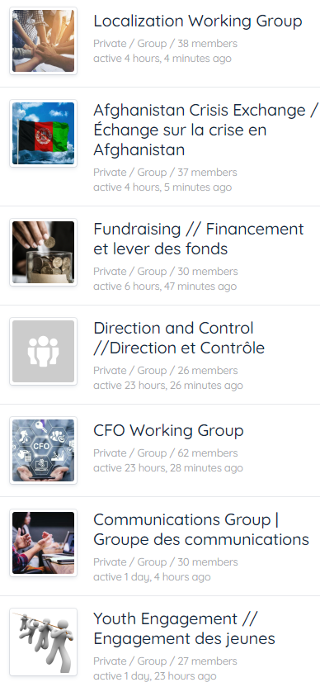
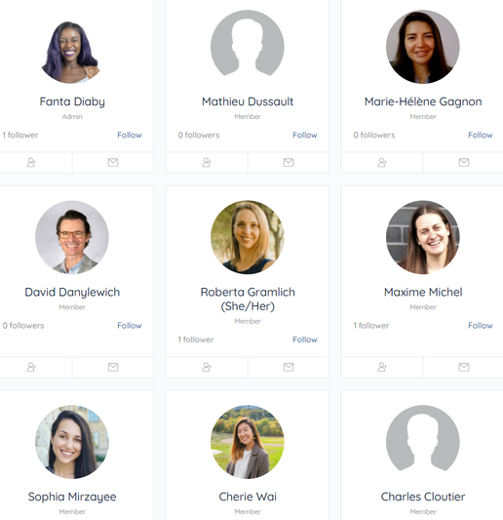
CONNECT
COMMUNITY OF PRACTICE
FORUM DISCUSSIONS
MEMBER-ONLY CONTENT
GLOBAL AFFAIRS UPDATES
MEMBER PORTAL

Slide 23
COMMUNICATING WITH STAKEHOLDERS AND THE PUBLIC. AMPLIFYING MEMBERS' VOICES.
Make sure we know what you're up to
We want to amplify you on Social Media! Tag us/e-mail us!
Our newsletters: where it's all happening
Website​: it's yours too!
WHAT ELSE DO WE OFFER?

Slide 24
GET ENGAGED
IDENTIFY CONTACTS
IN YOUR ORGANIZATION
JOIN COMMUNICATION LISTS
STRATEGIZE YOUR PARTICIPATION
MOBILIZE AND ENGAGE

Slide 25
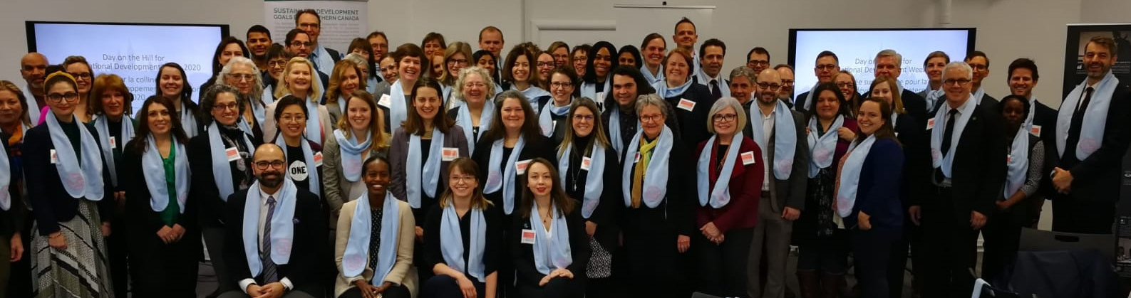
QUESTIONS?
THANK YOU

Slide 26
CONTACT
INFORMATION
MAILING ADDRESS
39 McArthur Avenue Ottawa, Ontario, K1L 8L7
GENERAL E-MAIL
info@cooperation.ca
MEMBERSHIP QUESTIONS
mpboisvert@cooperation.ca
MEDIA INQUIRIES
communications@cooperation.ca

